Slide 1

6th Grade Math
Unit 7, Lesson 10 Multiplying Integers Using Integer Chips Volume 2, pg. 47

Slide 2


Benchmark
MA.6.NSO.4.2
Apply and extend previous understandings of operations with whole numbers to multiply and divide integers with procedural fluency.
volume 2, pg. 47

Slide 3
Integrated Mathematical Thinking and Reasoning Standards
MA.K12.MTR.2.1 Demonstrate understanding by representing problems in multiple ways.
MA.K12.MTR.5.1 Use patterns and structure to help understand and connect mathematical concepts.
volume 2, pg. 47

Slide 4

Learning Target
I can use integer chips to multiply integers.
volume 2, pg. 47

Slide 5

Warm-Up
volume 2, pg. 47

Slide 6
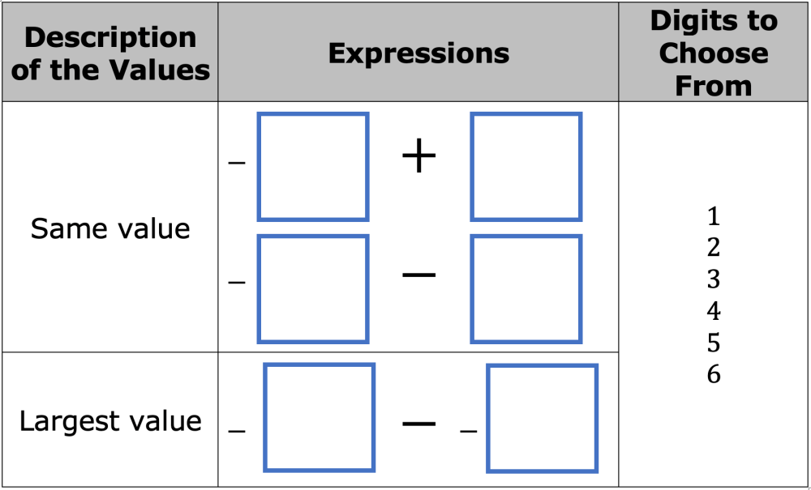
7.10.1 Warm-Up: Adding and Subtracting
Place a digit in each blue box so that the expressions in the first row have the same value and the expression in the second row has the largest value. Use only digits 1 to 6, at most one time each.
volume 2, pg. 47

Slide 7

Exploration
volume 2, pg. 48

Slide 8

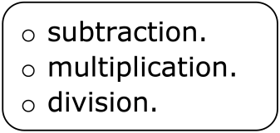
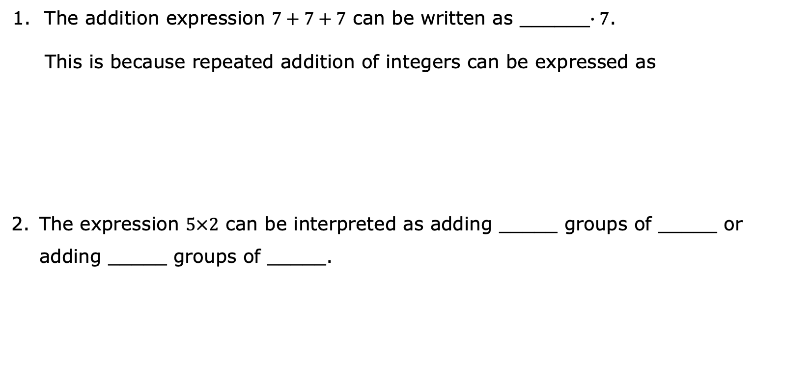
7.10.2 Exploration: Using Integer Chips to Represent Multiplication
The addition expression $7+7+7$ can be written as ______$∙7$.
This is because repeated addition of integers can be expressed as
The expression $5×2$ can be interpreted as adding _____ groups of _____ or adding _____ groups of _____.
volume 2, pg. 48

Slide 9


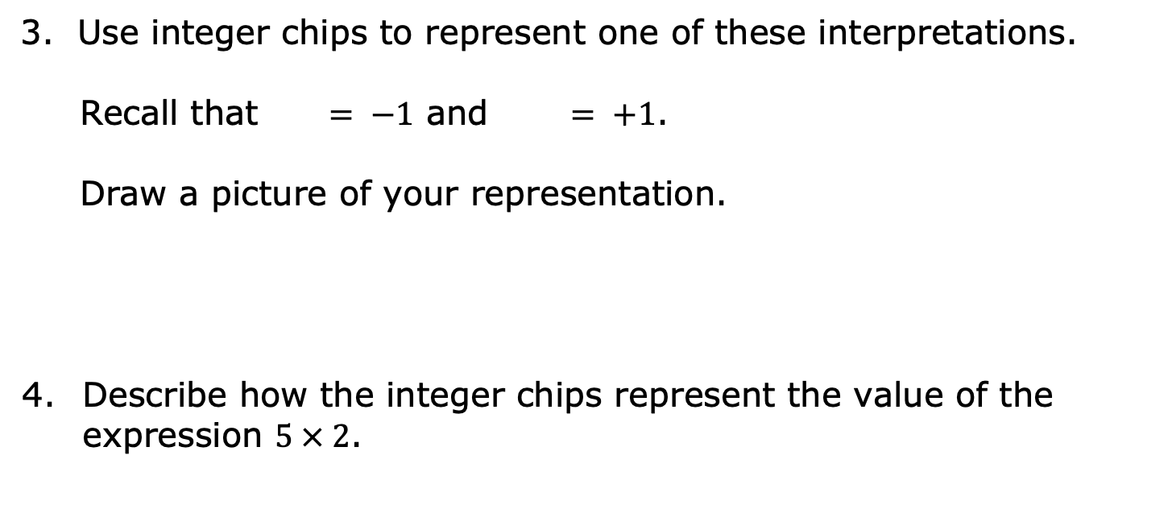
3. Use integer chips to represent one of these interpretations.
Recall that $= −1$ and $= +1$.
Draw a picture of your representation.
Describe how the integer chips represent the value of the expression $5 × 2$.
volume 2, pg. 48

Slide 10
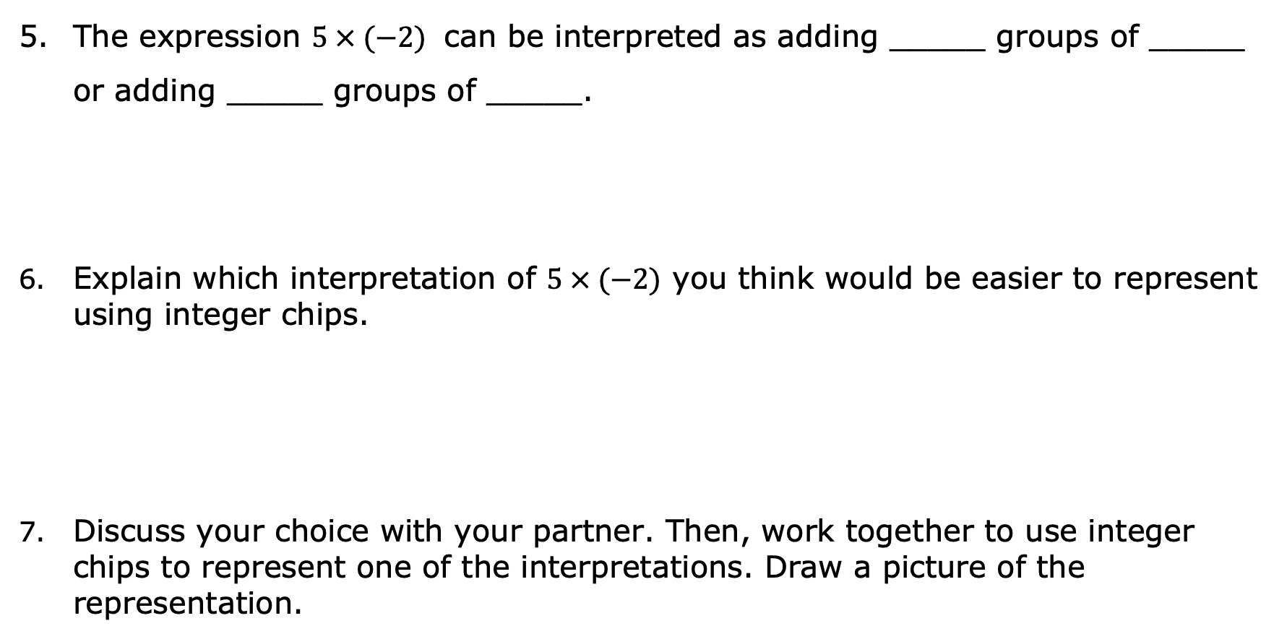
The expression $5 × (−2)$ can be interpreted as adding _____ groups of _____ or adding _____ groups of _____.
Explain which interpretation of $5 × (−2)$ you think would be easier to represent using integer chips.
Discuss your choice with your partner. Then, work together to use integer chips to represent one of the interpretations. Draw a picture of the representation.
volume 2, pg. 48

Slide 11

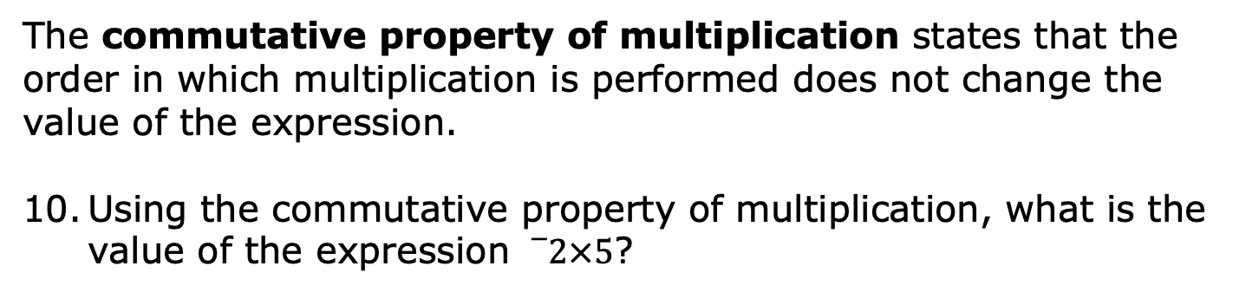
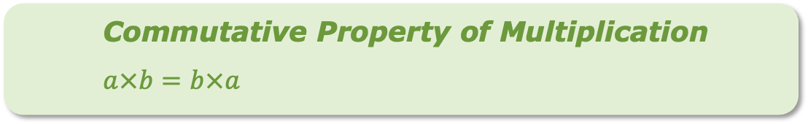
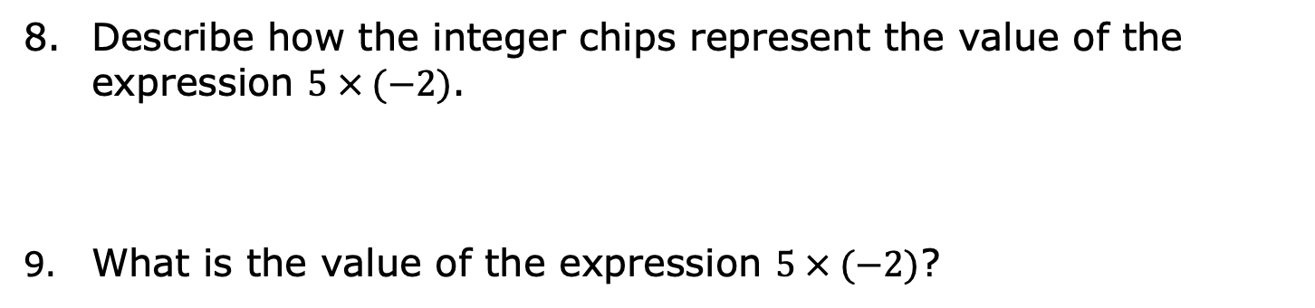
Describe how the integer chips represent the value of the expression $5 × (−2)$.
What is the value of the expression $5 × (−2)$?
Commutative Property of Multiplication
$$a×b=b×a$$
The commutative property of multiplication states that the order in which multiplication is performed does not change the value of the expression.
Using the commutative property of multiplication, what is the value of the expression ${}_{}^{−}2×5$?
volume 2, pg. 48

Slide 12

Collaboration
volume 2, pg. 49

Slide 13

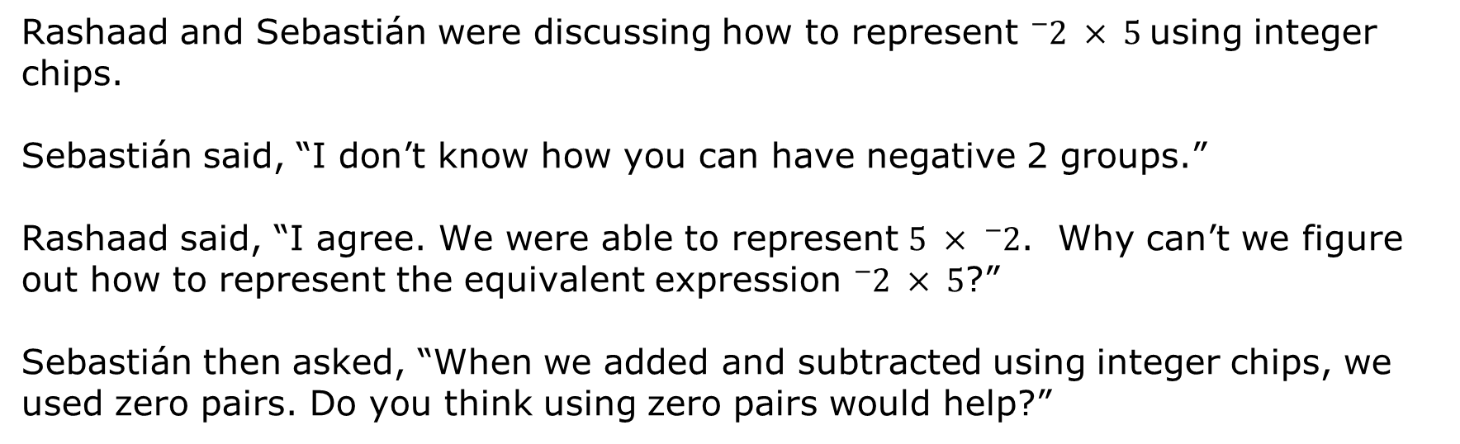
7.10.3 Collaboration: Are Zero Pairs Necessary for Multiplication?
Rashaad and Sebastián were discussing how to represent ${}_{}^{−}2 × 5$using integer chips.
Sebastián said, “I don’t know how you can have negative 2 groups.”
Rashaad said, “I agree. We were able to represent $5 × {}_{}^{−}2$. Why can’t we figure out how to represent the equivalent expression ${}_{}^{−}{2 }× 5$?”
Sebastián then asked, “When we added and subtracted using integer chips, we used zero pairs. Do you think using zero pairs would help?”
volume 2, pg. 49

Slide 14
Discuss with your partner Sebastián’s question, “Do you think using zero pairs would help?”
Briefly explain your answer to his question. Draw integer chips as part of your explanation if that is helpful.
volume 2, pg. 49

Slide 15
Exploration
volume 2, pg. 49

Slide 16
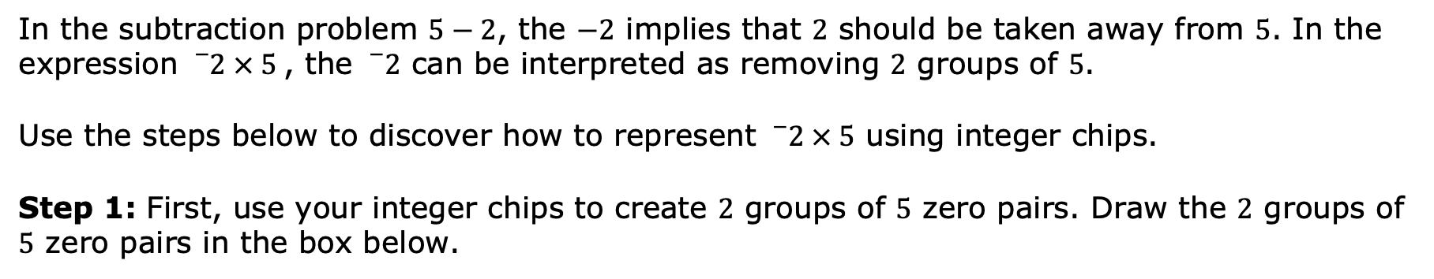
7.10.4 Exploration: Using Integer Chips to Represent Multiplication with Negative Groups
In the subtraction problem $5−2$, the $−2$ implies that $2$ should be taken away from $5$. In the expression ${}_{}^{−}2 × 5$, the ${}_{}^{−}2$ can be interpreted as removing $2$ groups of $5$.
Use the steps below to discover how to represent ${}_{}^{−}2 × 5$ using integer chips.
Step 1: First, use your integer chips to create $2$ groups of $5$ zero pairs. Draw the $2$ groups of $5$ zero pairs in the box below.
volume 2, pg. 49

Slide 17
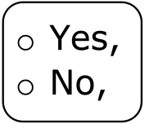
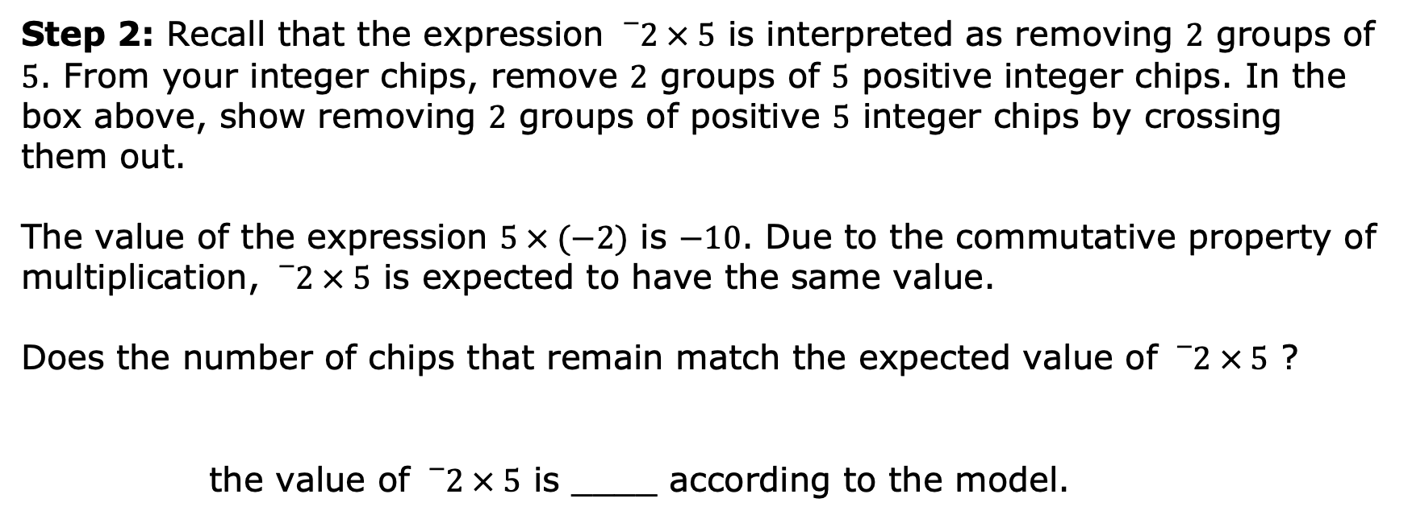
Step 2: Recall that the expression ${}_{}^{−}2 × 5$ is interpreted as removing $2$ groups of $5$. From your integer chips, remove $2$ groups of $5$ positive integer chips. In the box above, show removing $2$ groups of positive $5$ integer chips by crossing them out.
The value of the expression $5 × (−2)$ is $−10$. Due to the commutative property of multiplication, ${}_{}^{−}2 × 5$ is expected to have the same value.
Does the number of chips that remain match the expected value of ${}_{}^{−}2 × 5$ ?
the value of ${}_{}^{−}2 × 5$ is ____ according to the model.
volume 2, pg. 49

Slide 18

Try It
volume 2, pg. 50

Slide 19

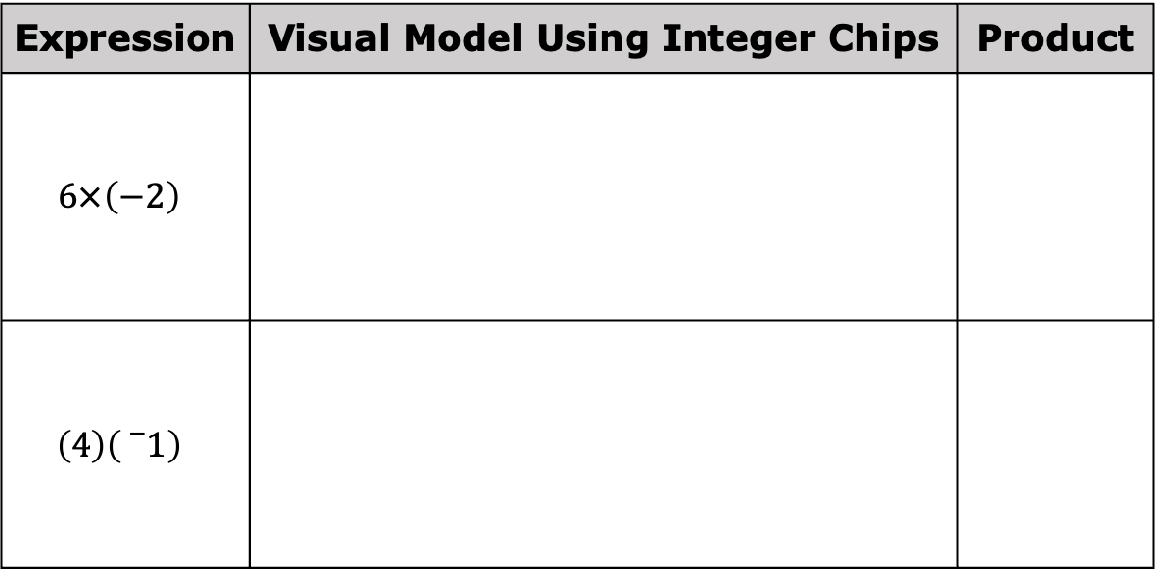
7.10.5 Try It: Multiplying Integers with Opposite Signs
Complete the table.
Expression | Visual Model Using Integer Chips | Product
$$6×\left(−2\right)$$
$$\left(4\right)\left({}_{}^{−}1\right)$$
volume 2, pg. 50

Slide 20
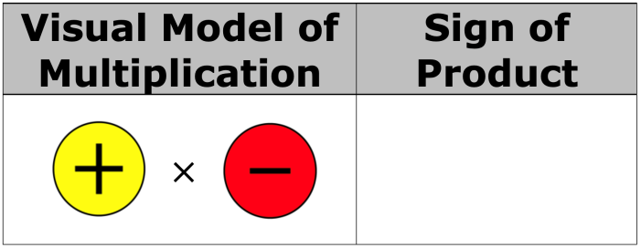
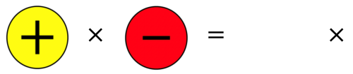
Use the pattern of the multiplication in the table to complete the rule by drawing the sign of the product as an integer chip.
Multiplication is commutative, so …
volume 2, pg. 50

Slide 21
Exploration
volume 2, pg. 50

Slide 22
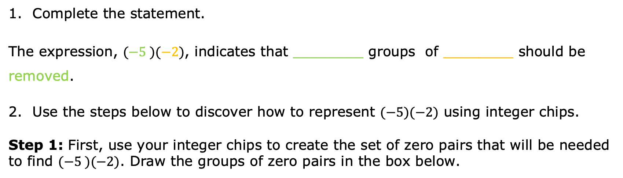
7.10.6 Exploration: Multiplying a Negative Integer by a Negative Integer
Complete the statement.
The expression, $(−5 )(−2)$, indicates that ________ groups of ________ should be removed.
Use the steps below to discover how to represent $(−5)(−2)$ using integer chips.
Step 1: First, use your integer chips to create the set of zero pairs that will be needed to find $(−5 )(−2)$. Draw the groups of zero pairs in the box below.
volume 2, pg. 50

Slide 23
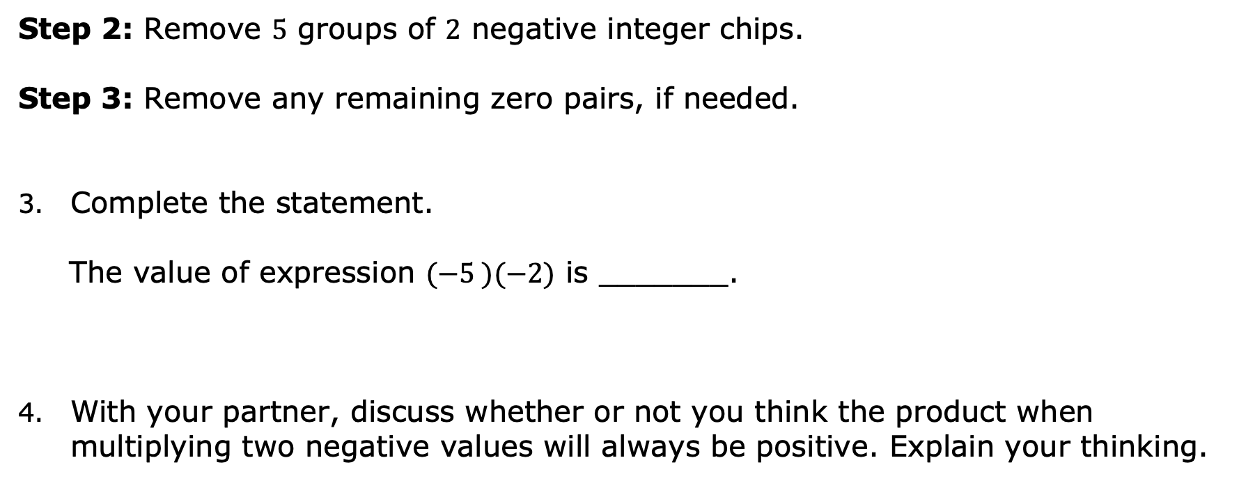
Step 2: Remove $5$ groups of $2$ negative integer chips.
Step 3: Remove any remaining zero pairs, if needed.
Complete the statement.
The value of expression $(−5 )(−2)$ is _______.
With your partner, discuss whether or not you think the product when multiplying two negative values will always be positive. Explain your thinking.
volume 2, pg. 50

Slide 24
Try It
volume 2, pg. 51

Slide 25
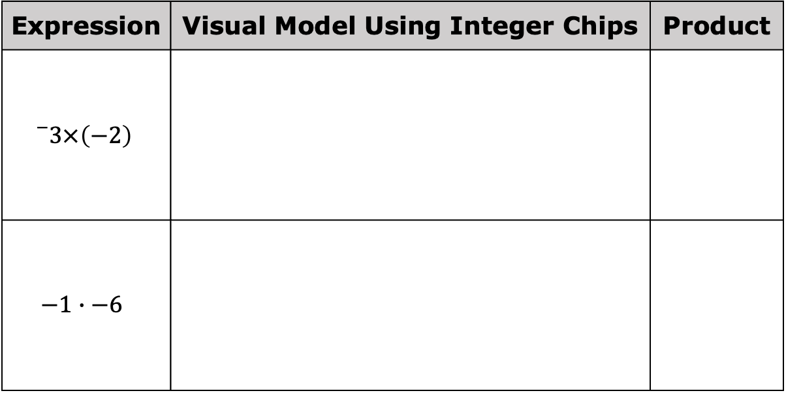
7.10.7 Try It: Multiplying a Negative Integer by a Negative Integer
Complete the table.
Expression | Visual Model Using Integer Chips | Product
$${}_{}^{−}3×\left(−2\right)$$
$$−1∙−6$$
volume 2, pg. 51

Slide 26
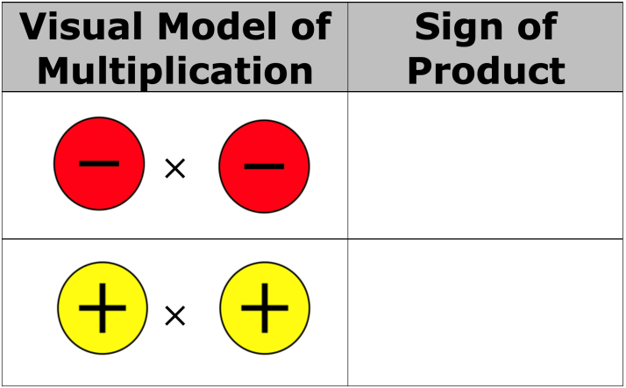
Complete each rule by drawing the sign of the product as an integer chip.
volume 2, pg. 51

Slide 27

Wrap-Up
volume 2, pg. 51

Slide 28
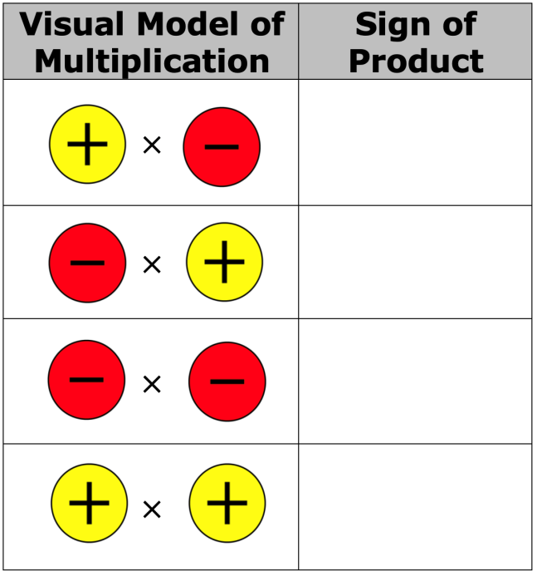
7.10.8 Wrap-Up: Cool Down
Complete each rule by drawing the sign of the product as an integer chip.
volume 2, pg. 51

